Slide 1

SOTS
Shree Om Techno Services

Slide 2

Shree Om Techno Services
ABOUT US
SHREE OM TECHNO SERVICES (SOTS) established in 2014. SOTS is technology leader in Engineering, Automotive and Power Sector , is ranked in top 10 facilities in Pune with world-class products designed and analysis, engineered and manufactured by a diverse team of talented employees. Over time, we have grown and diversified our capabilities by introducing different products. We are committed to excellent quality and innovative ideas for the customer. Long lasting relationships with our customers and vendors is a fundamental goal at SOTS. We help our customers design new products, redesign an existing project and investigate cost savings.

Slide 3

Shree Om Techno Services
ANIL SHETE
DIRECTOR
From Mechanical Field pass out from Pune University and having 20 years of experience in Industry.
Worked in companies like Mahindra Ugine Steel (MUSCO)in areas like Production planning , Controlling & Supply Chain Management.

Slide 4
Shree Om Techno Services
MESSAGE FROM DIRECTOR
A young company, SOTS, is founded and driven by passion, experience and commitment of engineers from leading companies in India who have hundreds of man months experience of the Auto component industry,
Projects and Metal Industry between them.
SOTS is a fast expanding company with access to adequate resources for working collaboratively with customers to provide metal tube /channel and sheet metal based complete solutions for assembly fixtures, shop floor as well as parts transportation trolleys and in-situ fabrication.

Slide 5

Shree Om Techno Services
SOTS VISION
To become preferred vendor for providing solutions using innovative design and manufacturing engineering.

Slide 6
Shree Om Techno Services
Organization Structure
CEO
PLANT HEAD
HR
BUSINESS
DEVELOPMENT
OPERATION
QMS
MATERIAL STORE
FINANCE
DESIGN AND DEVELOPMENT
EMPLOYEE
PROJECTS
Company Strength
Company Staff Members
18 no's
Company Workmens
90 no's

Slide 7
Shree Om Techno Services
Key Achievements
Tier One Supplier OEM Companies. Etc M & M, TATA
Started 2 Unit in April 2017
Under Process 3 Unit in Nashik (Maharashtra)
Top two Trolley/Pallet supplier to M&M, FIAPL and it’s key tier one suppliers

Slide 8
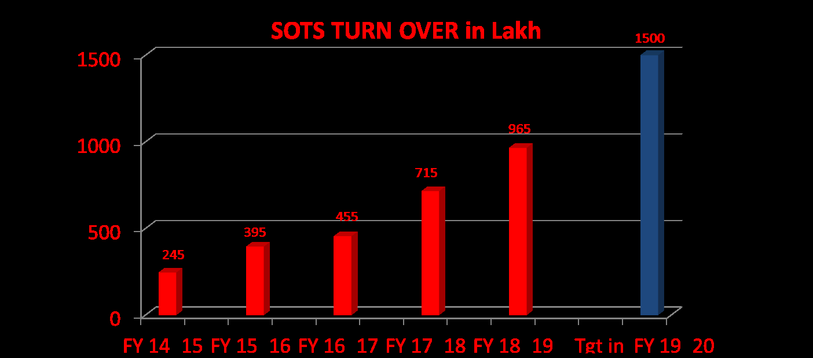
Shree Om Techno Services
Progression of Yearly Sales

Slide 9
Shree Om Techno Services
Manufacturing Facilities available
SR NO. | MACHINE | SPECIFICATION | QTY
1 | Tig welding | 400 amp | 4
2 | Mig welding-co2 | Gmaw300 & 400 amp | 14
4 | Mig welding-arc | Smaw- 300 amp | 4
5 | Profile cutting | Up to 40 mm | 1
6 | Band saw |  | 4
7 | Radial drill | Up to 50 mm dia. | 1
8 | Portable drill machine | Up to 18 mm dia. | 1
9 | Pillar drill machine |  | 2
10 | Lathe machine | Bed size 5.5 & 3.3 feet | 2
11 | Chop saw |  | 3
12 | Spray painting shop | 1200 sq feet | 1
13 | Shearing Machine | 6-8 mm | 1
14 | Bending Machine | 6-8 mm | 1
15 | Milling machine | 4800x1250 &1000x450 bed size | 2

Slide 10
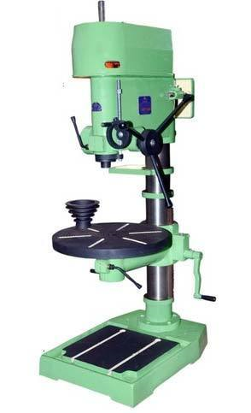
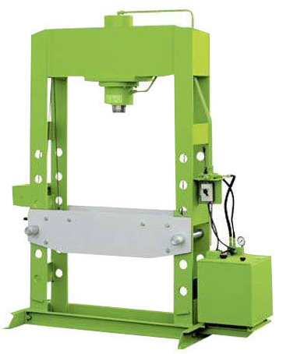
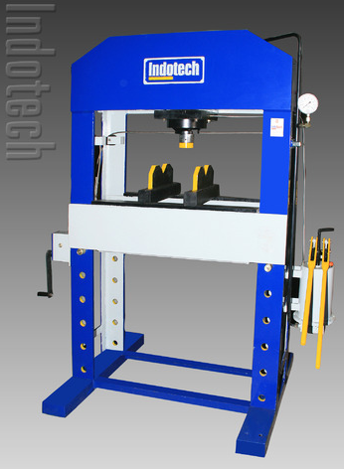
Manufacturing Facilities available
Shree Om Techno Services
Pillar Drilling Machine – 2 nos
50 Ton Hydraulic Press Machine–1 nos
80 Ton Hydraulic Press Machine–1 nos

Slide 11
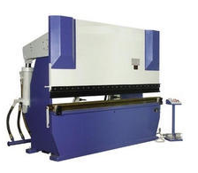
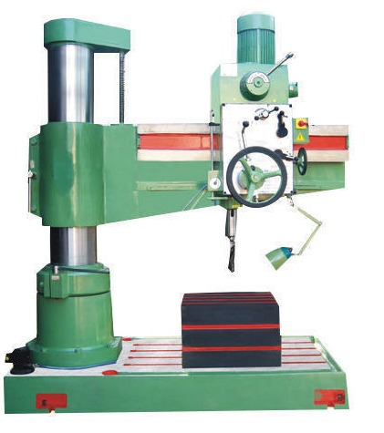
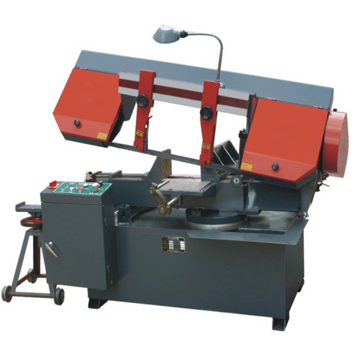
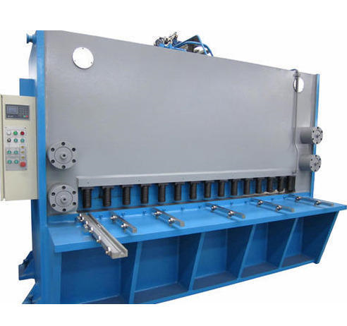
Manufacturing Facilities available
Shree Om Techno Services
Bending Machine – 2 nos
Band Saw Machine –4 nos
Hydraulic Radial Drilling Machine– 1 nos
Hydraulic Shearing Machine – 1 Nos

Slide 12
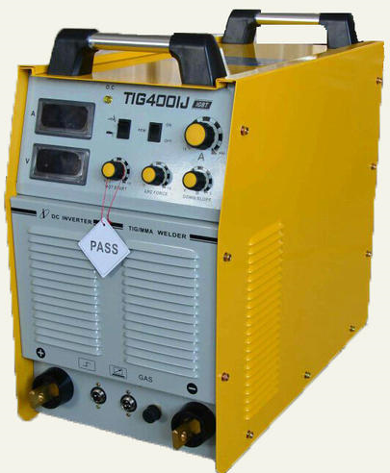
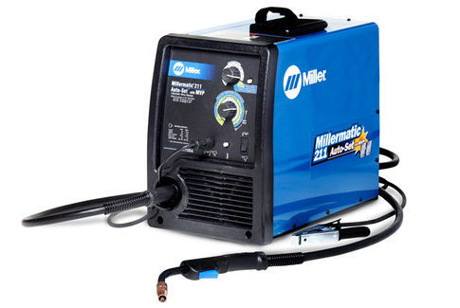
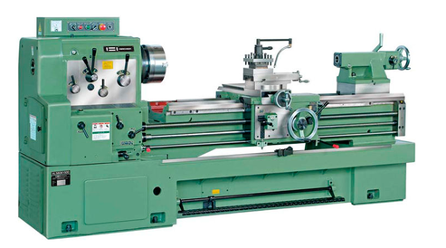
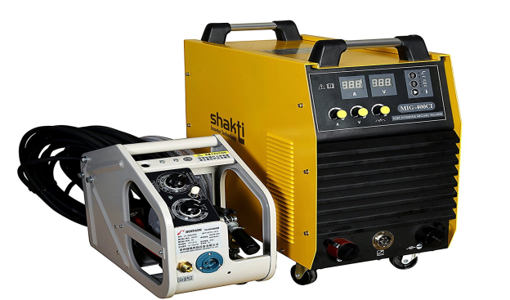
Manufacturing Facilities available
Shree Om Techno Services
Mig Welding Machine – 14 nos
Tig Welding Machine – 4 nos
Lathe Machine – 2 nos
Mig Welding Machine Arc – 4 nos

Slide 13
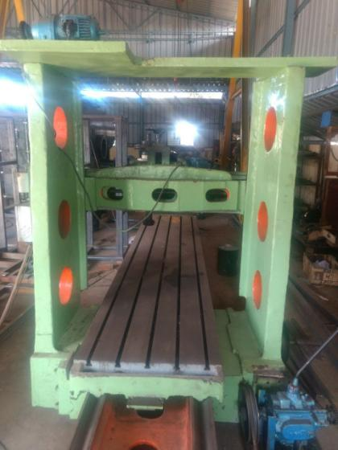
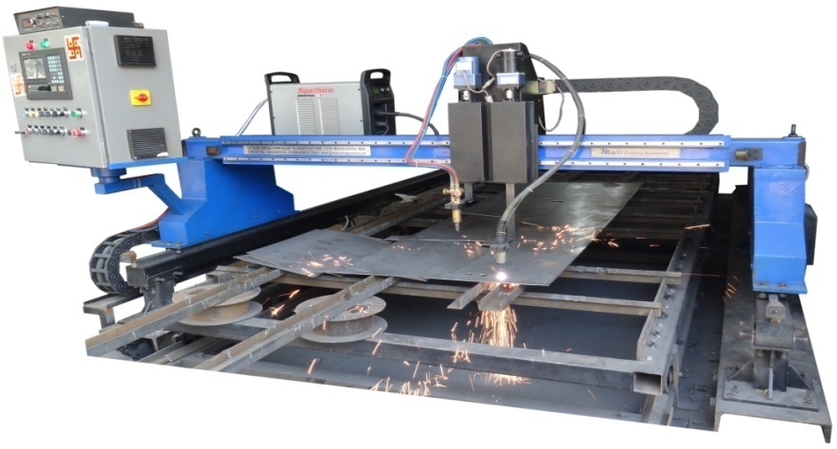
Shree Om Techno Services
Manufacturing Facilities available
Plano Milling Machine – 1 Nos
Profile Cutting Machine – 1 Nos

Slide 14
Shree Om Techno Services
Manufacturing Facilities available
SR NO. | MACHINE | SPECIFICATION | QTY
1 | Press machine | 50 tone | 5
2 | Press machine | 80 tone | 2
3 | Press machine | 100 tone | 1
4 | Center less grinding |  | 1
5 | Shearing machine | Shearing capacity-up to 5mm | 1
6 | Spot welding machine | 24 kva | 1
7 | Bench grinder |  | 1
8 | Pillar drill machine |  | 1
9 | Mig welding co2 | 300 amp | 4

Slide 15
Shree Om Techno Services
Product AND SERVICES
Our company provides Design, Manufacturing and Assembly solutions in Automotive, Engineering and Power sectors.
Assembly & Fabrication
Material Handling Equipment
❑ Auto component Assy.
❑ Engineering Fabrication & assy.
❑ Civil Fabrication
❑ Hand trucks
❑ Scissor tables
❑ Trolley for material movement
Storage Systems
Pallets and Crates
❑ Heavy duty storage rack
❑ FIFO Industrial rack
❑ Pipe joint storage
❑ Railings
❑ Raw Material pallets
❑ Skin component pallets
❑ 1 Ton & 2 Ton bins
❑ Mesh bins
Special Designed
Conveyors
❑ Manufacturing Fixtures
❑ Assembly Fixtures
❑ Inspection Fixtures
❑ Industrial roller conveyors
❑ Gravity conveyors
❑ Motorized conveyors
Engineering Product
Support Services
❑ Skids – Machine platforms
❑ Air receivers
❑ Engineering assemblies
❑ Gear housing
❑ Any kind of work at Customer end
❑ TPM Horizontal deployment
❑ Maintenance support
❑ IED Support
Power sector
❑ Wind mill structure
❑ Solar structure

Slide 16
Shree Om Techno Services
PRODUCTS

Slide 17
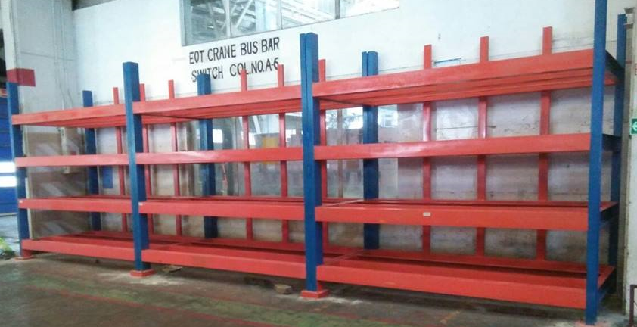
Shree Om Techno Services
STORAGE SYSTEM PRODUCT
Storage Racks

Slide 18
Shree Om Techno Services
DESIGN PROCESS
Study Of IGS Data Received From Customers
Work On Conceptual Design
Approval Of Concept Design
Work On Design & Drafting
DAP
Final Submission Of Design
Modification in CAD File According to Analysis Report
Modification After DAP
Simulation (Analysis)

Slide 19
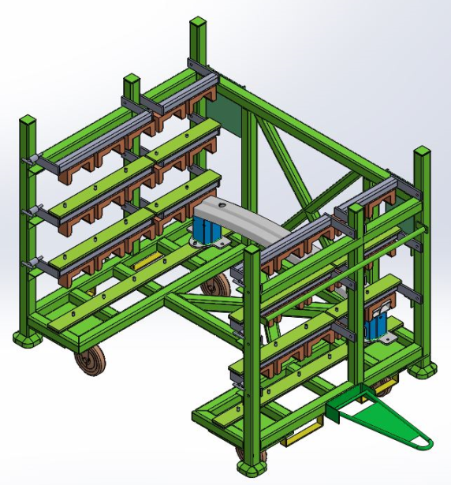
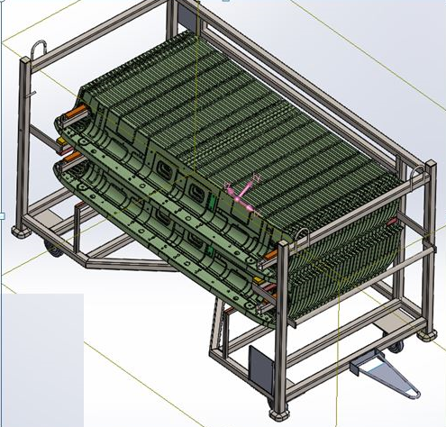
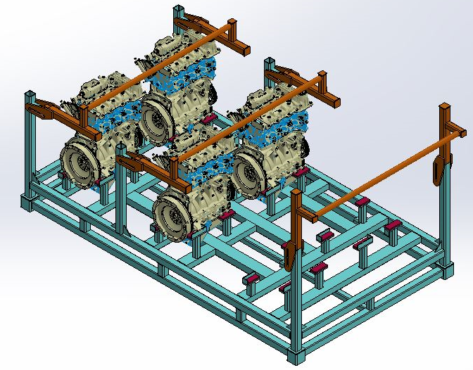
Shree Om Techno Services
DESIGN & SIMULATION
1. DESIGN -

Slide 20
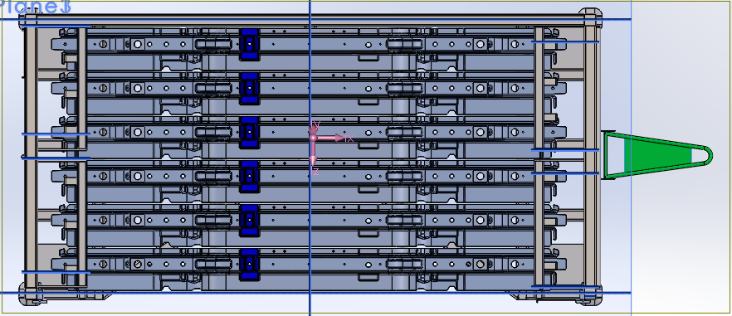
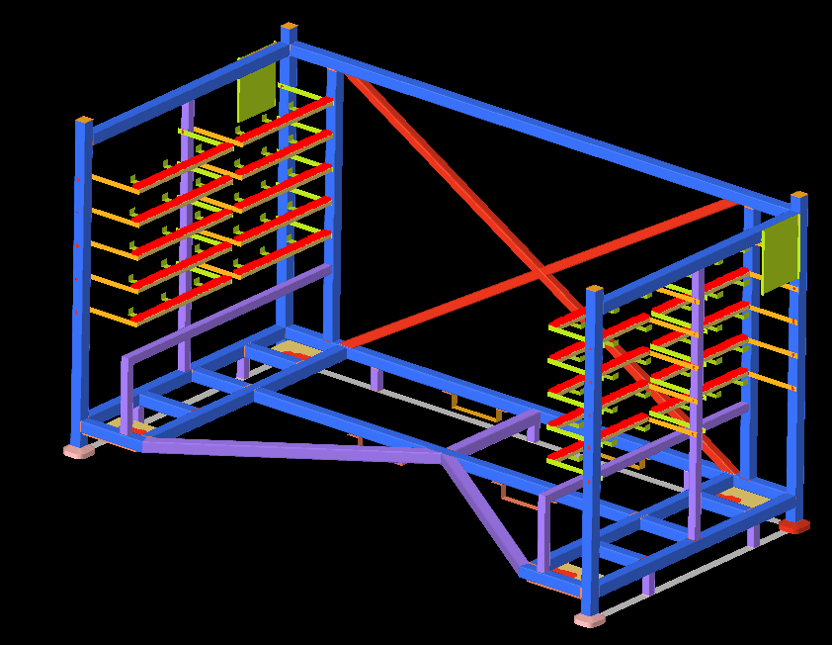
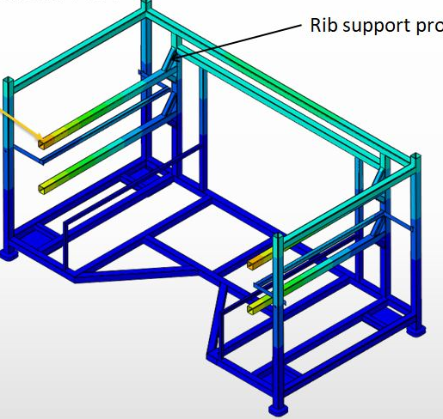
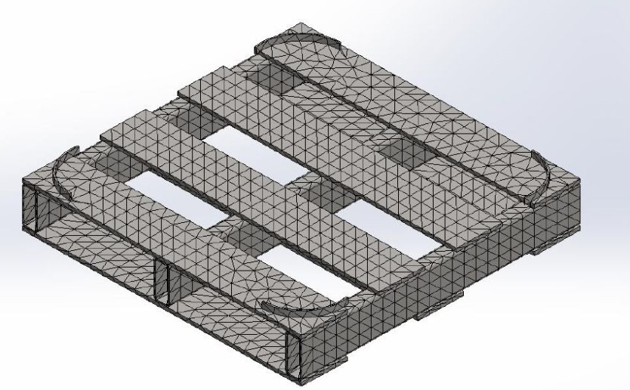
Shree Om Techno Services
2. SIMULATION -

Slide 21
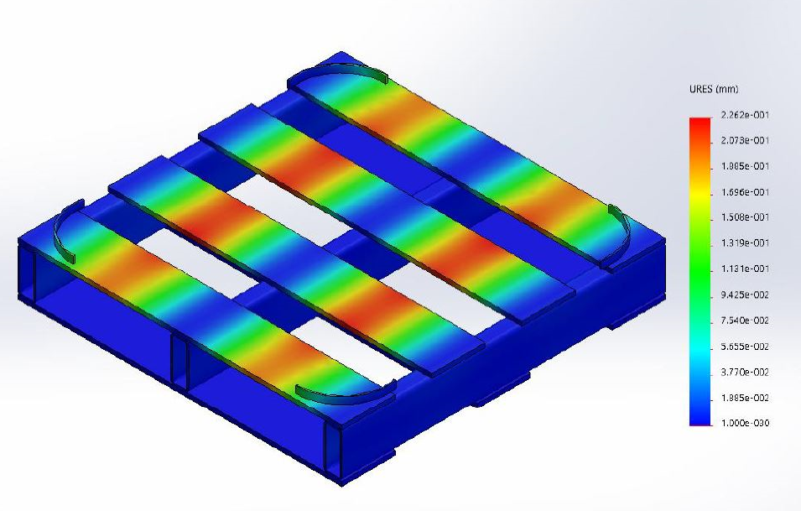
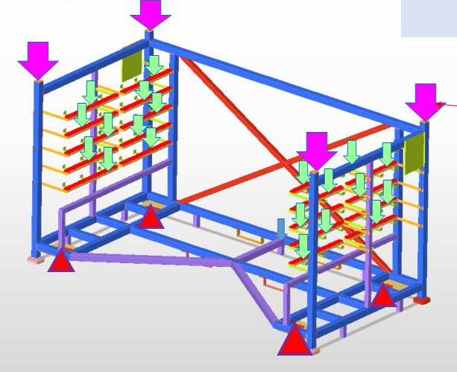
Shree Om Techno Services

Slide 22
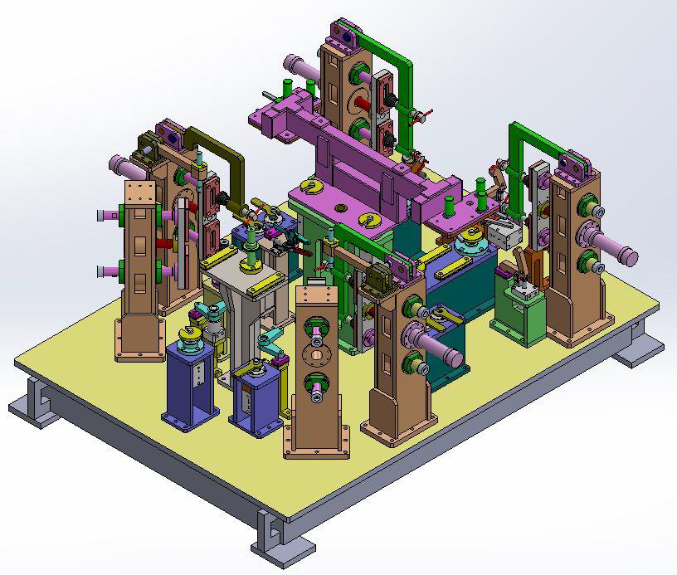
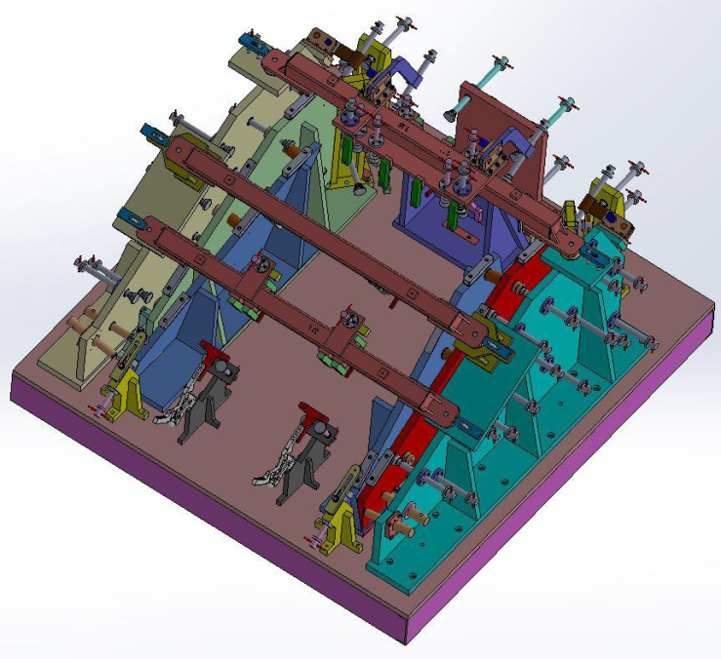
Shree Om Techno Services
WELDING FIXTURE

Slide 23
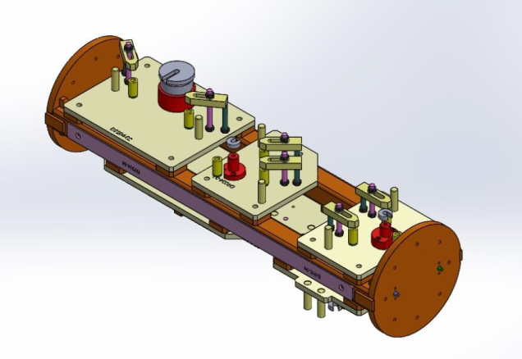
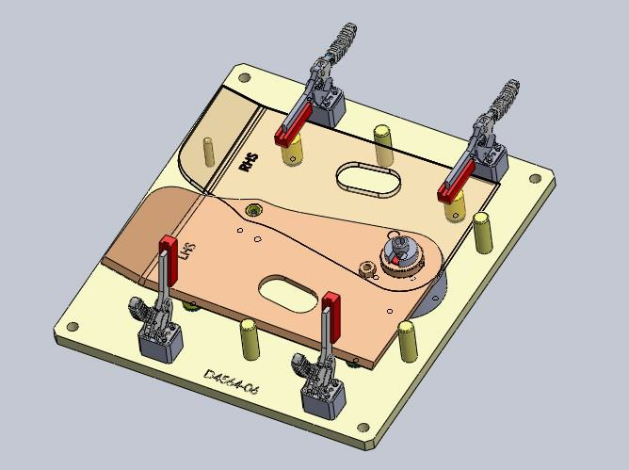
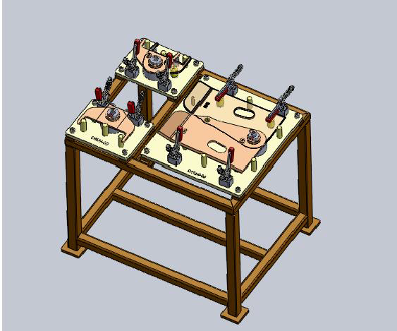
Shree Om Techno Services
WELDING FIXTURE

Slide 24
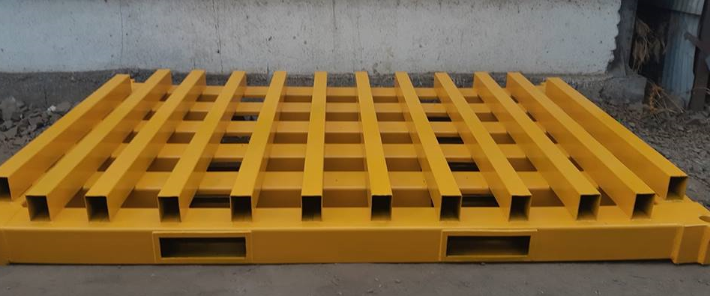
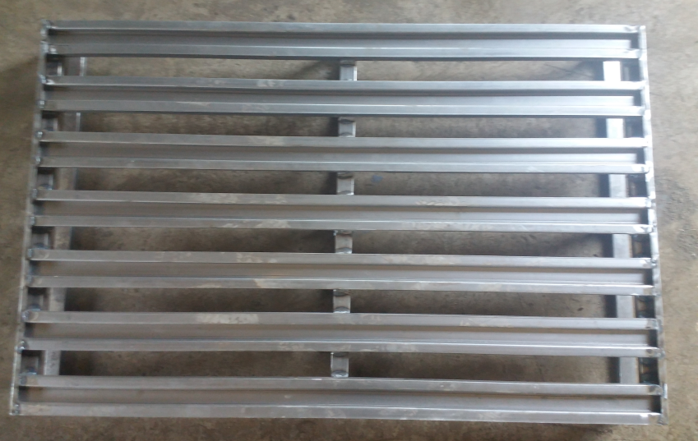
Shree Om Techno Services
PALLETS
Pallet (Blanking pallet Capacity 30 MT)
M.S. Pallet( Light weight pallet capacity 1 MT)

Slide 25
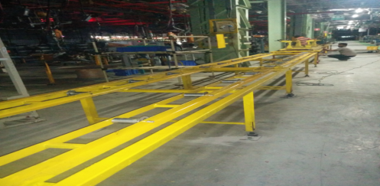
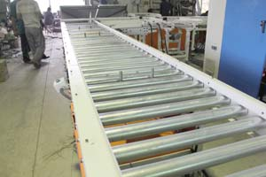
Shree Om Techno Services
CONVEYORS
Roller Conveyor Installed at Track Component
Gravity Conveyor Installed at M&M line

Slide 26
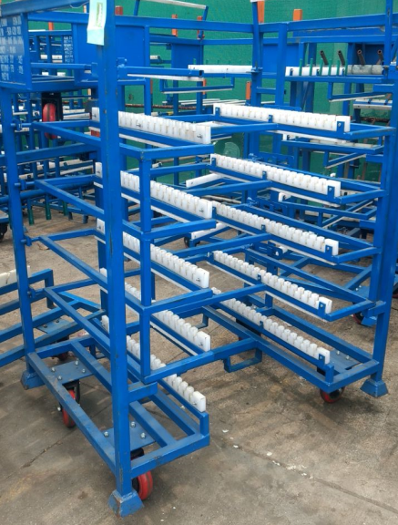
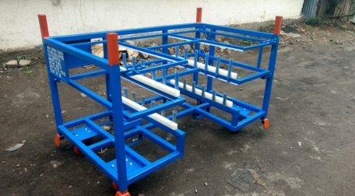
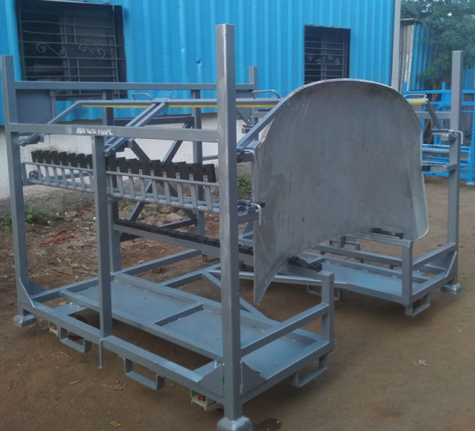
Shree Om Techno Services
AUTO SECTOR PRODUCTS
BIW Trolleys
TCF Trolleys
Jeep Compass Skin Panel handling Trolley

Slide 27
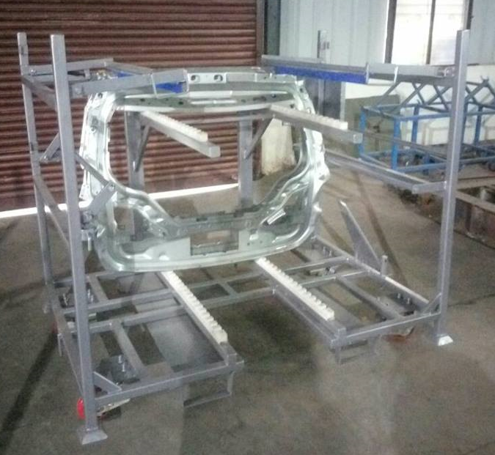
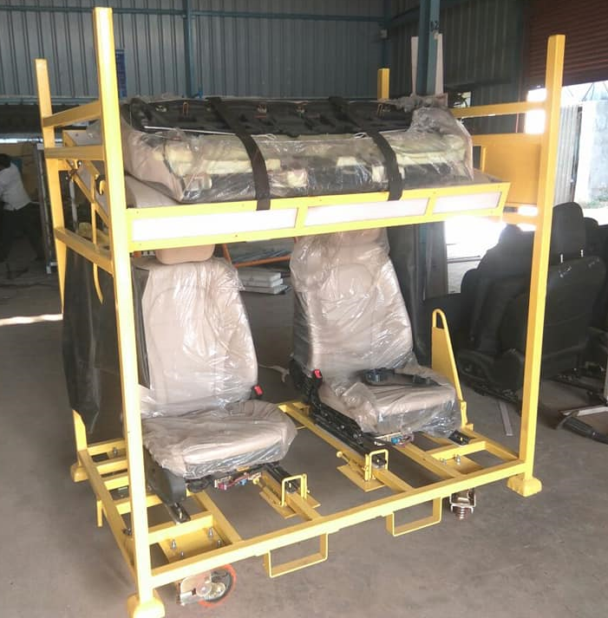
Shree Om Techno Services
FCA Skin Panel Trolley to FIAT
KUV 300 Seat Trolley

Slide 28
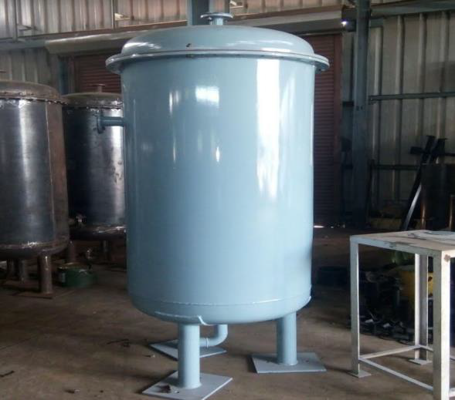
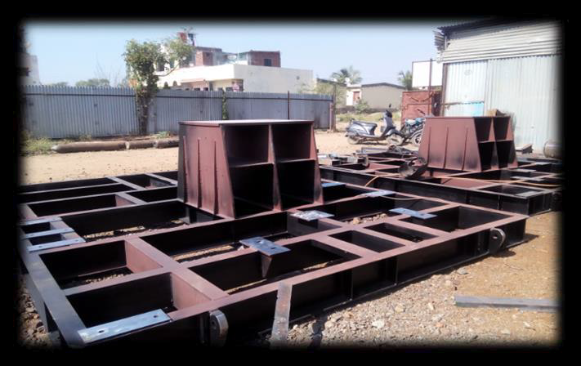
Shree Om Techno Services
ENGINEERING SECTOR PRODUCTS
Compressor Base Frame
Pressure Vessel 2m3

Slide 29
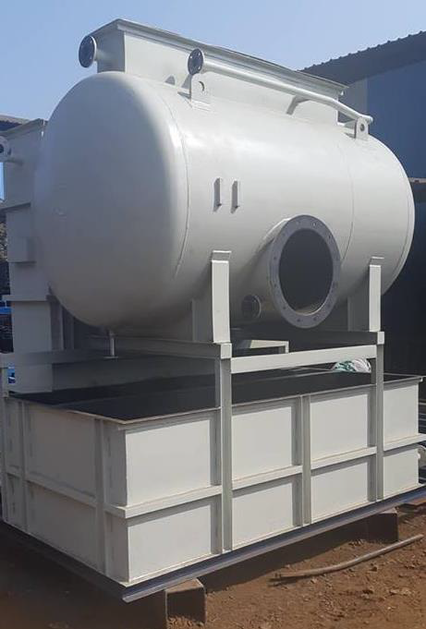
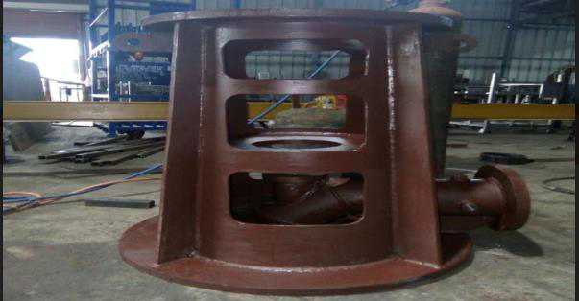
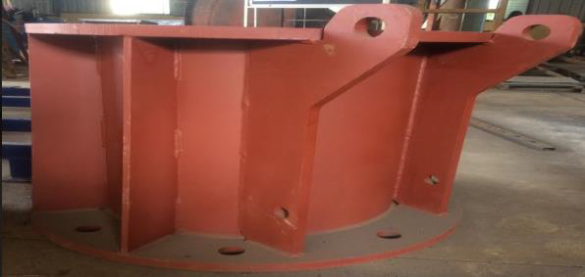
Shree Om Techno Services
ENGINEERING SECTOR PRODUCTS
Bio-Cass Assembly Of STP Plant
Delivery bend & motor stool , Pump Stools

Slide 30






Shree Om Techno Services
SUCESSFULLY COMPLETED PROJECTS -
Mahindra TUV 300
Jeep Compass
Mahindra KUV 100
TATA Harrier
TATA Nexon
Mahindra XUV 300

Slide 31
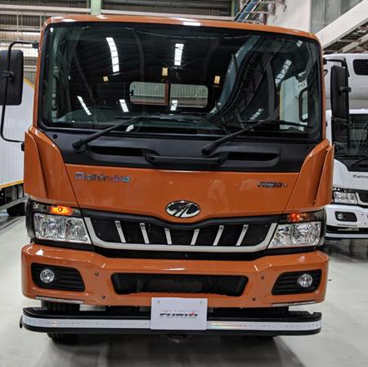
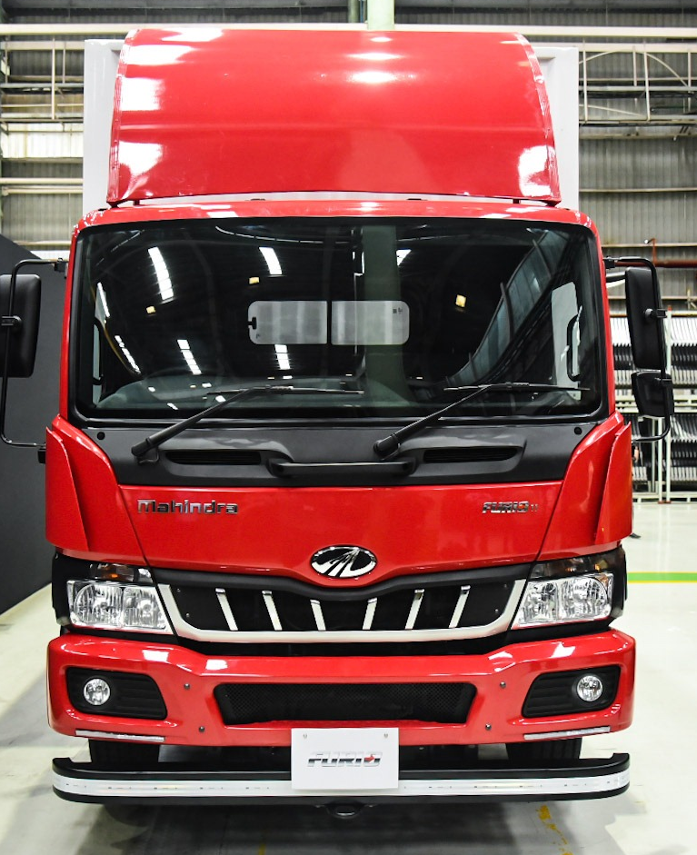
Shree Om Techno Services
SUCESSFULLY COMPLETED PROJECTS -
Mahindra Truck
Mahindra ICV

Slide 32




Shree Om Techno Services
CUSTOMERS
1. Auto Sector -

Slide 33
Shree Om Techno Services
Contact us

Slide 34
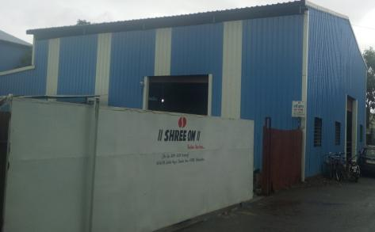
Shree Om Techno Services
Company Location
How To Reach us-
We are located close to customer location in Pune, near to industrial hub to offer better services.
Shree Om Techno Services
Gat No. 105,Jyotiba Nagar, Talawade
Pune-411062,
Maharashtra, India

Slide 35



Shree Om Techno Services
Contact details
- shreeomtechno@sots-pune.com
- www.sotspune.com
Contact Persons-
1. Mr. Anil Shete
-9850969651
marketing@sots-pune.com

Slide 36
Shree Om Techno Services
Thank you
Shree Om Techno Services
Office & Company Address – Gat No 105 , Jyotiba Nagar, Talawade,Pune-411062.
Phone No.+9850969651 Email- shreeomtechno@sots-pune.com

